Slide 1
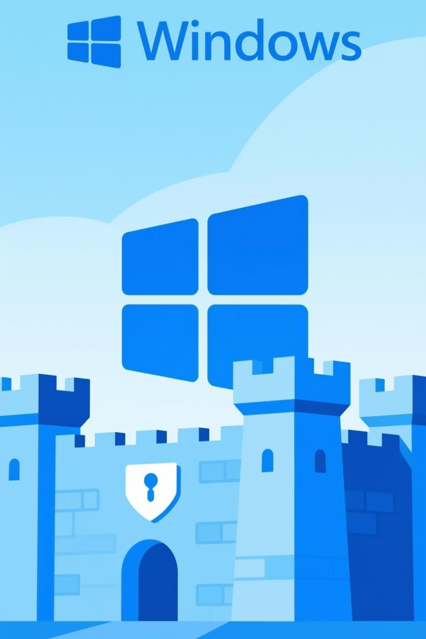
A Survey on Windows Login Bypass Techniques
The Evolution from Offline Attacks to the Modern Live System Battlefield
Presenter: Atharva Jagtap
Date: 15 Nov 2025

Slide 2

The Red Teamer's Dilemma
Access vs. Integrity: The Core Conflict
Mission Objective
Gain access to live Windows systems for intelligence extraction—particularly volatile memory analysis
The Critical Problem
Traditional password resets trigger defender alerts
Destructive methods compromise forensic integrity
Encrypted data becomes permanently inaccessible
The Holy Grail
The Intact Bypass: Access the system while preserving original state-including user credentials

Slide 3



The Classic Attack Vector
Offline System Exploitation: The Old Playbook
Boot from External Media
Direct File Access
Credential Manipulation
Launch attacker-controlled OS (Linux USB) bypassing Windows kernel security
Windows security mechanisms inactive—unrestricted filesystem access achieved
Modify SAM database or registry to establish access
Technique 1: SAM Modification
Technique 2: Sticky Keys Attack
Tools like chntpw directly edit the Security Account Manager database to blank or reset passwords
Replace accessibility binary (sethc.exe) with cmd.exe for SYSTEM-level shell at login

Slide 4





The Defender's Response
How Microsoft Built a Hardware-Anchored Fortress
BitLocker FDE
UEFI Secure Boot
Full disk encryption renders SAM file and registry completely unreadable when system is offline
Cryptographic verification blocks unauthorized operating systems from booting via external media
TPM Hardware Vault
Physical security chip refuses decryption key release if boot integrity is compromised
Result: Entire class of offline attacks nullified on properly configured modern systems

Slide 5

The New Attack Surface
Exploiting the Live, Running System
With offline vectors blocked, attackers target vulnerabilities in active OS components and hardware interfaces
01
02
Rogue USB Devices
DMA-Based Memory Attacks
LAN Turtle & Similar: Emulate network adapter, forcing locked PC to expose NTLM password hash over fake Ethernet connection
Thunderbolt Exploitation: Direct Memory Access via high-speed ports to extract credentials from RAM—largely mitigated by Kernel DMA Protection
03
Windows Hello Biometric Bypass
IR Spoofing: Custom USB devices inject fake facial recognition data
Database Tampering: With admin privileges, add attacker biometrics to victim's authentication profile

Slide 6
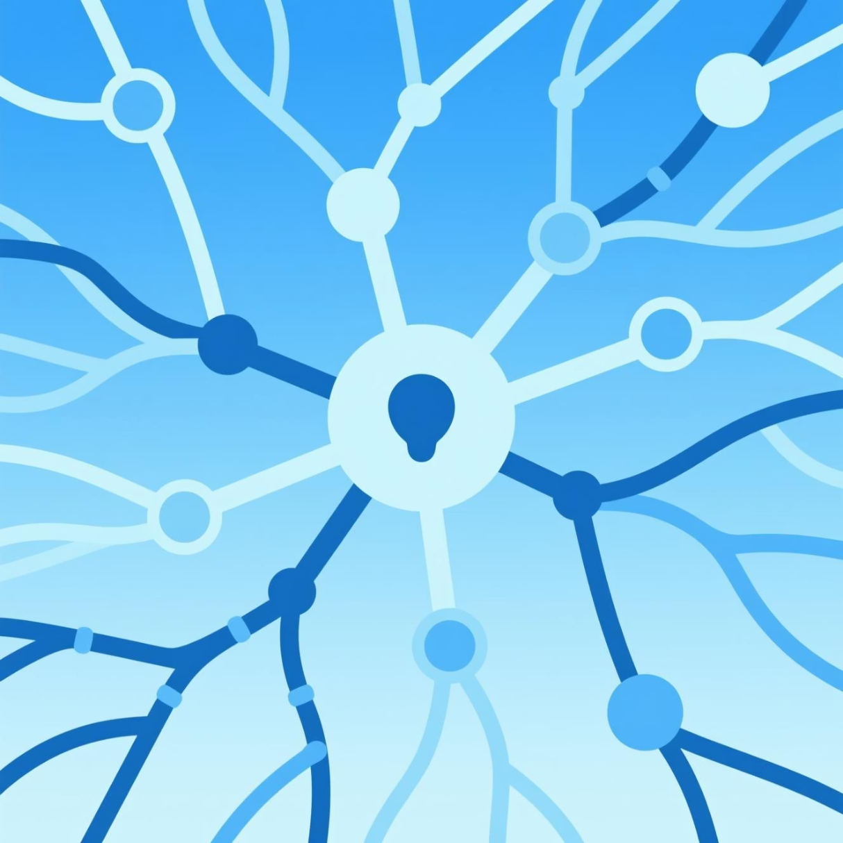
Future Research Directions
The Theoretical Pursuit of a Universal Bypass Framework
Manual Hacking
Manual, hands-on exploitation work to probe Windows security at the operator level.
Develop a multi-vector framework that combines different attack surfaces and techniques.
Build a single, targeted tool intended to achieve persistent, non-destructive circumvention of core Windows architectural defenses.
Move research beyond conventional software bugs to expose side-channel and implementation-flaw vulnerabilities.
Focus on weaknesses in underlying hardware and platform components that form the foundation of Windows security.

Slide 7








Future Research Directions
AI-Driven Offensive Security
Observe State
Select Action
Agent analyzes system configuration, permissions, services
Deep RL model chooses optimal exploit sequence
Learn & Adapt
Receive Reward
Neural network refines attack strategies autonomously
Success/failure feedback trains decision-making
Paradigm Shift: From human-speed to machine-speed attacks—an inevitable AI arms race in cybersecurity

Slide 8

Conclusion
Key Takeaways
1
The Old Ways Are Gone
Classic offline SAM and registry attacks fail against encrypted, secure-booted Windows systems
2
The Battlefield Has Shifted
Focus now on live system vulnerabilities—Windows Hello, hardware interfaces, transient misconfigurations
3
The "Universal Bypass" is a Myth (as of Present)
No single tool defeats all modern, patched Windows systems—success is exploit-dependent and configuration-specific
4
The Future Hacking could be Autonomous
System complexity drives AI-powered attack tool development, demanding equally sophisticated AI-based defenses

Slide 9

Thank You
Questions & Discussion

